Slide 1

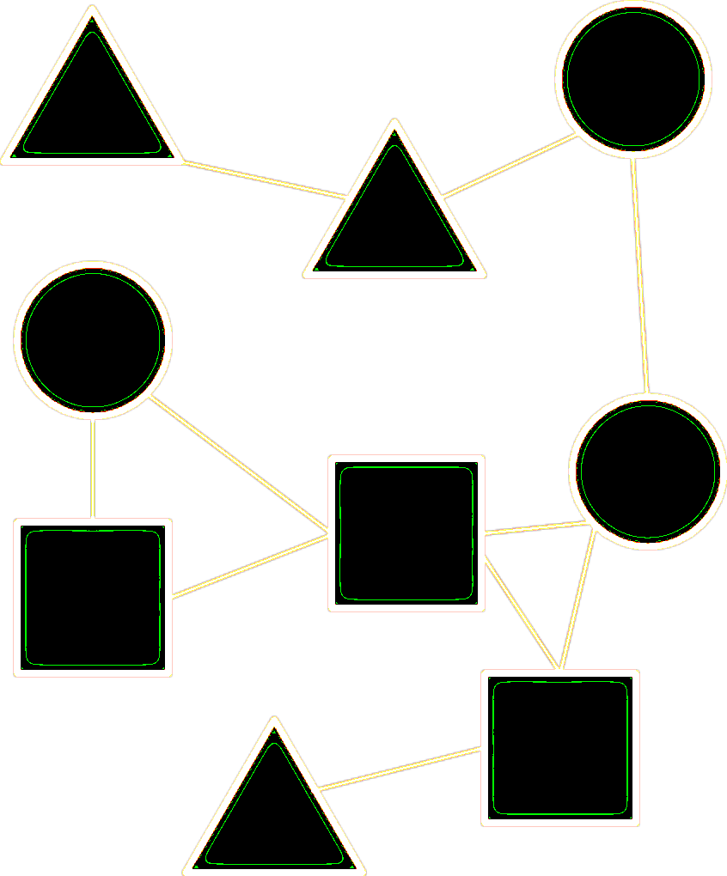
Evolution of complex sexual signals in barn swallows
Matt Wilkins University of Nebraska-Lincoln @mattwilkinsbio
Notes:
Thank you all for coming.
I appreciate the opportunity to talk about part of my Postdoc at UNL
Which builds on my Phd work
With Rebecca Safran at CU

Slide 2
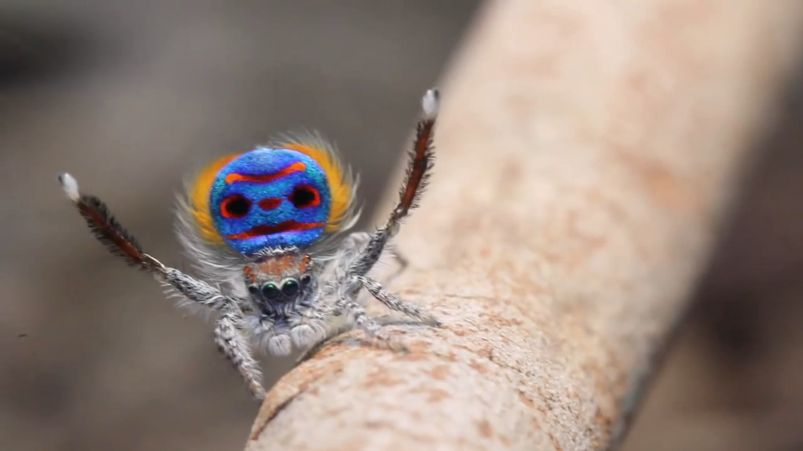
Signals Are Often Complex
Jürgen C. Otto
Notes:
Animal signals are often complex
(seen here in the sweet dance moves of this Peacock spider)
difficult to quantify everything that is going on here: visually--color, pattern, movement; acoustic and possibly chemical signals, as well.
Also challenging to determine which aspects of phenotype are important in a given signaling context

Slide 3
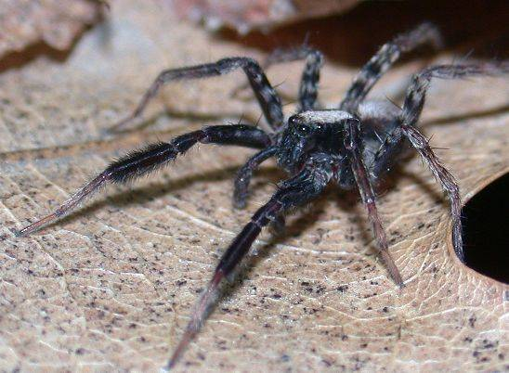
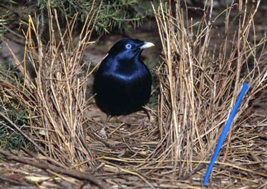
Why multiple components?
Redundant signals :
backups
receiver stimulation
improve chance of reception
Multiple messages :
greater information
reduce search costs
Uetz An Beh 2009
Doucet, Beh Eco 2003
(Hebets & Papaj 2004)
(Partan & Marler 2005)
Notes:
Why mult comp? when a single signal more cost effective from signaler perspective
Mult. Sigs may be redundant:
Schizocosa ocreata: Visual and acoustic signals presented in isolation resulted in equivalent response
Mult signals may convey different messages:
Bowerbirds: UV plumage predicts intensity of blood parasite infection; Bower quality predicts ectoparasite

Slide 4
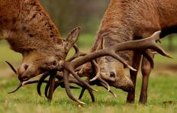
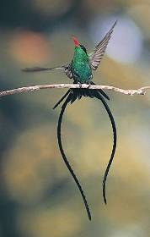
Sexual Selection
Why multiple components?
Multiple receivers :
Sexual Selection
Operates by:
Competition for mates
Female choice
Notes:
Alternative received less attention
Different signals are targeted at different receivers
This may apply more broadly, but I’ll explain it from a sexual signaling perspective….
These examples are at two obvious ends of the spectrum
Red deer antlers are clearly evolved for combat; these hummingbird streamers evolved through female choice bc hard to grow & maintain
However, know little about which traits function in one context or the other or both
Elk; Red-billed streamertail from Jamaica

Slide 5
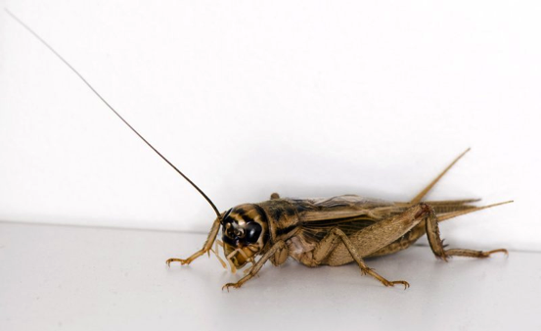
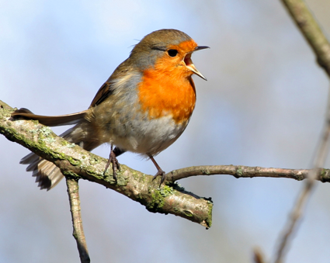
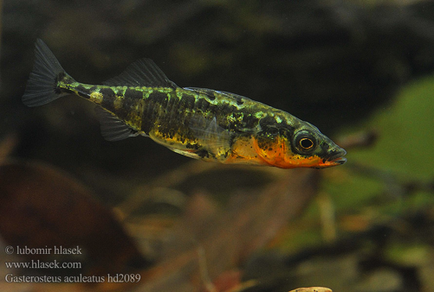
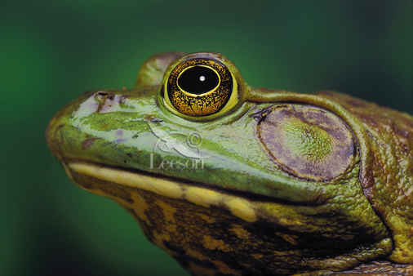
Sexual Selection
Why multiple components?
Multiple receivers :
Most multiple context studies are for a single trait
Studies incorporating complexity and multiple contexts are necessary
Hunt, et al. JEB 2009
Notes:
Most studies looking at trait function across SS contexts, 1 trait
From this: Vocalizations and color may be used in both competition and mate choice
Studies incorp complexity and mult sig contexts necessary to improve our understanding
of the evolution of signaling systems
This is clearly challenging

Slide 6
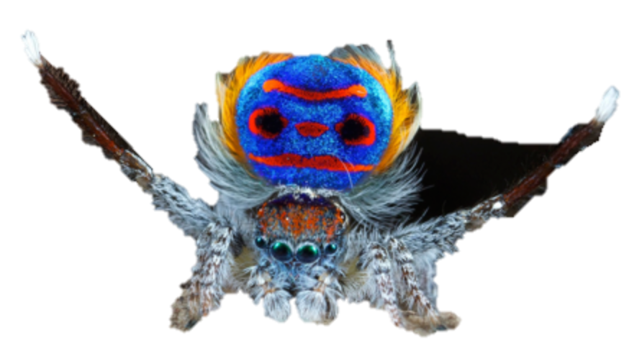
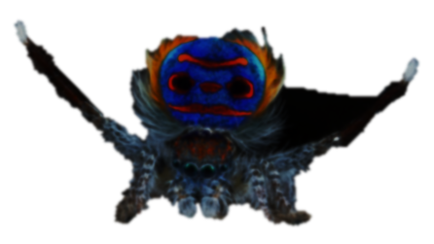
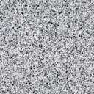
The study of complexity
Manipulate
Trait
Remove
Modality
Notes:
Diff traits & modalities may have additive/dominance/ or emergent effects
Vary across spp.
There will always be other traits or combos, AND some traits can’t be manipulated
These considerations make this approach infeasible for most systems
In order to design appropriate experiments,
It’s important to recognize these traits act w/in a system
Manip 1 trait may have unexpected effects if we don’t take into account
The underlying corr. structure of the system.

Slide 7
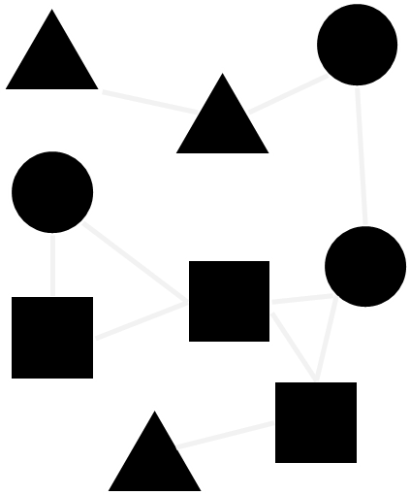
Phenotype Networks
An Alternative Approach
Wilkins, et al Proc B 2015
Notes:
Proposing phenotype networks as a novel approach for visualizing and testing hypotheses about
signaling architecture and the evolution of communication systems
To inform experiments within and synthesis across systems

Slide 8
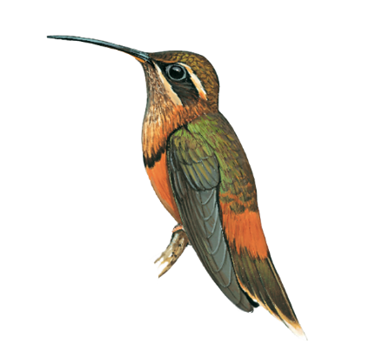
Color
Hue, Brightness, Chroma
Song
Frequency, Timing, Composition
Morphology
Size, Feather or Bill Length
Notes:
I’ll explain with a heuristic example
…
Throughout triangles=color, circles= song, squares=morph
Not modalities, but trait modules which we’d a priori expect to be more correlated based
On shared development or physiology

Slide 9

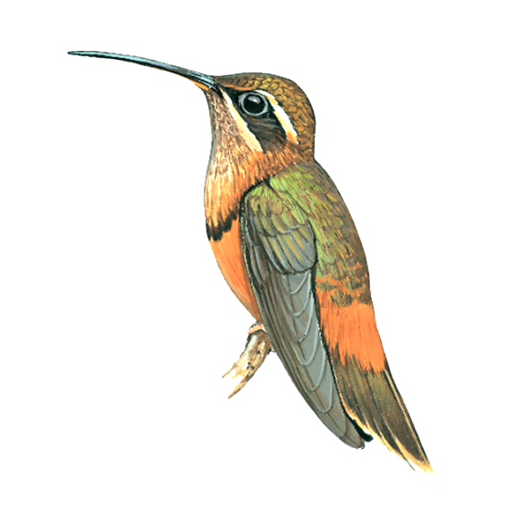
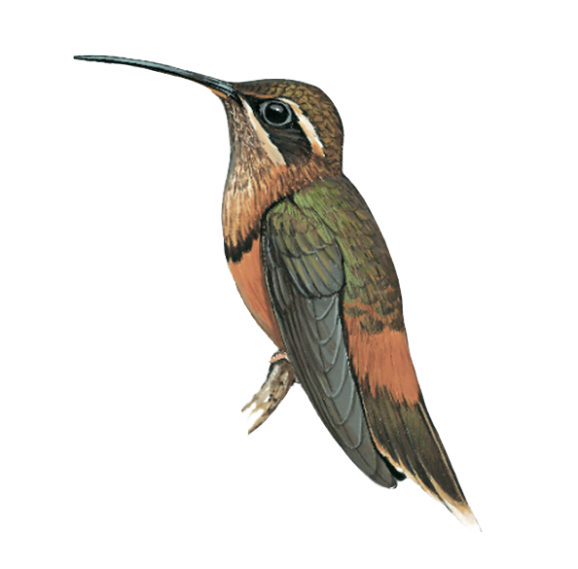

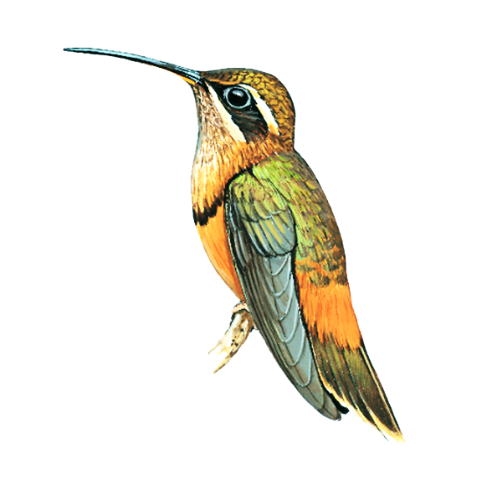
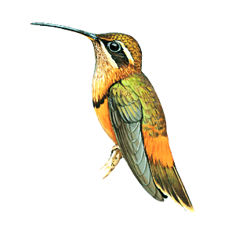
Notes:
Here, each shape represents a measured trait, which will be a network node
By measuring traits in a pop, we can look at correlations
Connections or edges b/w nodes reflect strong correlations

Slide 10
Notes:
Here, connections between shapes represent strong correlations, which may highlight underlying genetic, physiological, or hormonal determinants,
And may also reflect something about underlying selection pressures within the population

Slide 11
Conceptual Predictions

Slide 12
A)
Redundancy
Modularity
♫♪♫
Notes:
We can establish some conceptual figures along two axes: modularity (the number of trait clusters) and redundancy (the degree of connectedness within clusters)
As an example, if bill length, body size, pitch, and song duration are all highly intercorrelated, you might find a pattern like this (basically 1 highly connected module)

Slide 13
A)
B)
Redundancy
Modularity
Notes:
Might have two modules with high redundancy
If morphological and song traits are highly intercorrelated, but weakly correlated to each other

Slide 14
A)
B)
Redundancy
Modularity
C)
Notes:
You could also have no strong pattern of modularity or redundancy

Slide 15
A)
B)
Redundancy
Modularity
C)
D)
Notes:
Or modularity at the cost of redundancy

Slide 16
Backup Signals
Redundancy
Modularity
Multiple
Messages
Notes:
Backup signals: Occlusion of any particular trait has little effect on receivers
Multiple messages: each cluster can convey different information about age, quality, or motivation

Slide 17
1) Complex trait architecture
Overall Approach:
2) Functions across contexts
3) Integrate results
Notes:
The goals are to use this approach to characterize complex trait architecture of a wild study system
Assess which traits are associated with success across competitive and mate choice contexts
Integrate these two results to gain insights into how different forms of sexual selection shape the evolution of communication systems as a whole.

Slide 18
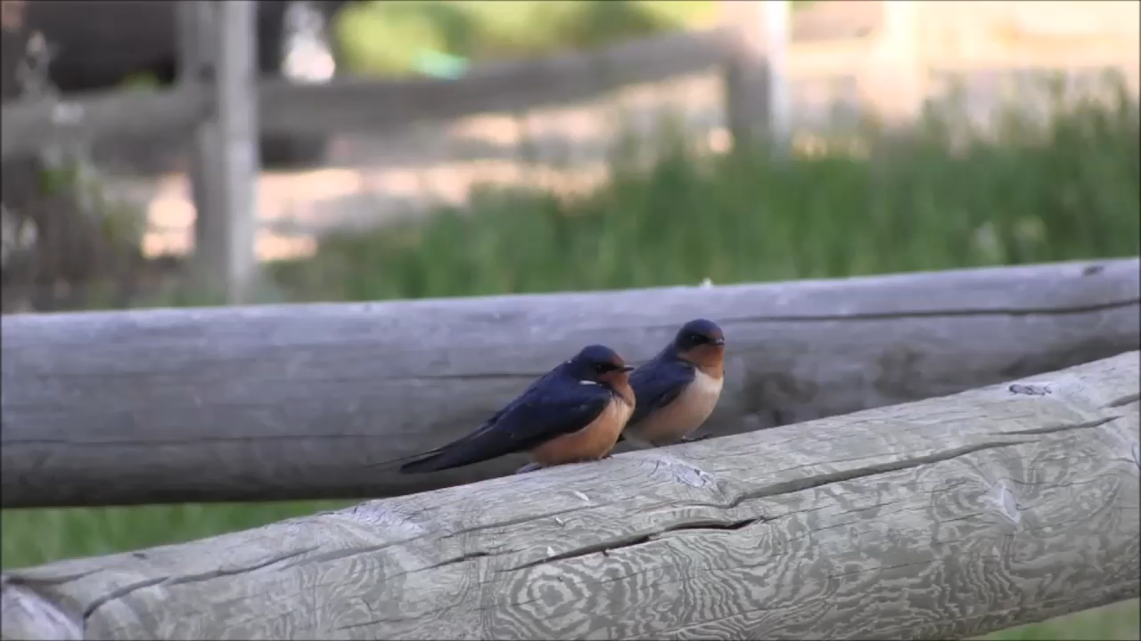
Study System: Hirundo rustica erythrogaster
Matt Wilkins
Notes:
We studied North American barn swallows in Boulder, CO;
Semi-colonial, migratory, songbird
Nesting in human structures
Males arrive in early spring, defend territories
Females come later, choose nest and mate
In this subspecies, dark ventral coloration is preferred by females, although song has not previously been studied in detail

Slide 19
Measured Phenotypes

Slide 20
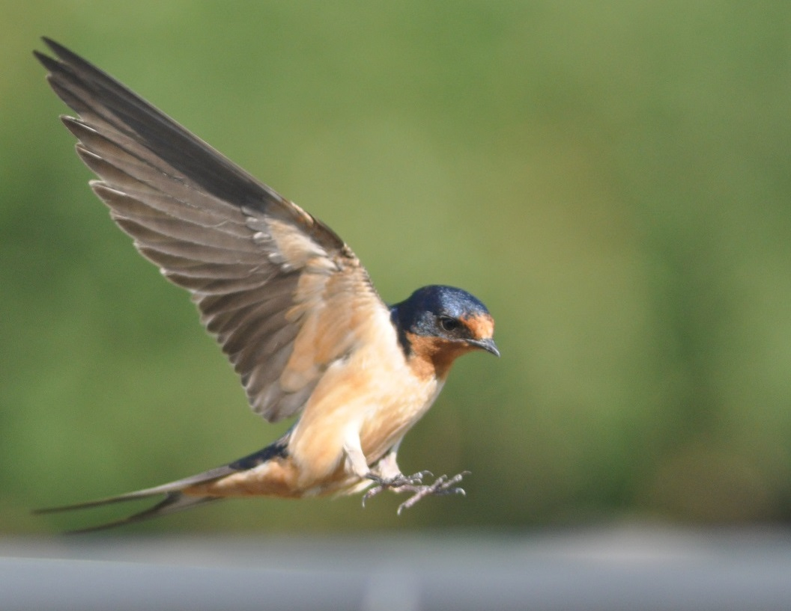
Wing Length
Tail Streamer
Length
Throat Color
Breast Color
Belly Color
Vent Color
Matt Wilkins
Notes:
Morphology: wing length and tail streamer
Color: brightness, hue, chroma—throat, breast, belly, vent

Slide 21
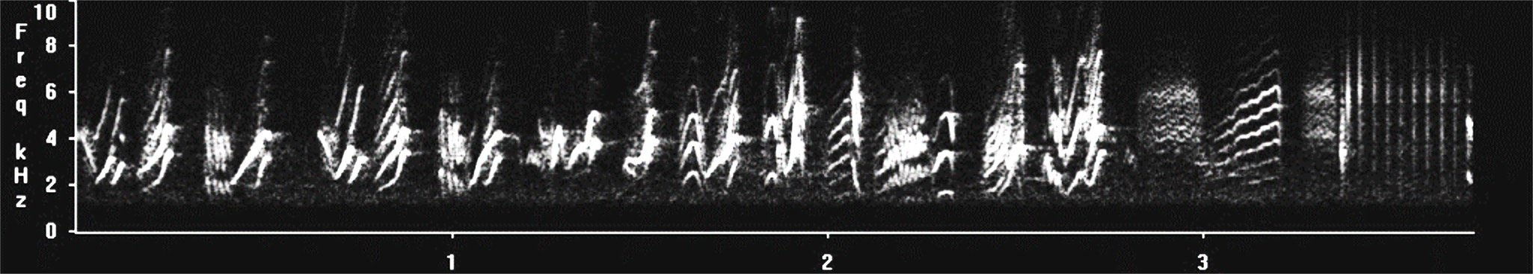
Song
Notes:
Explain spectrogram

Slide 22
Song
Syllable

Slide 23
Song
Warble
Syllable

Slide 24
Song
Warble
P-Note
Syllable

Slide 25
Song
Warble
P-Note
Rattle
Syllable

Slide 26
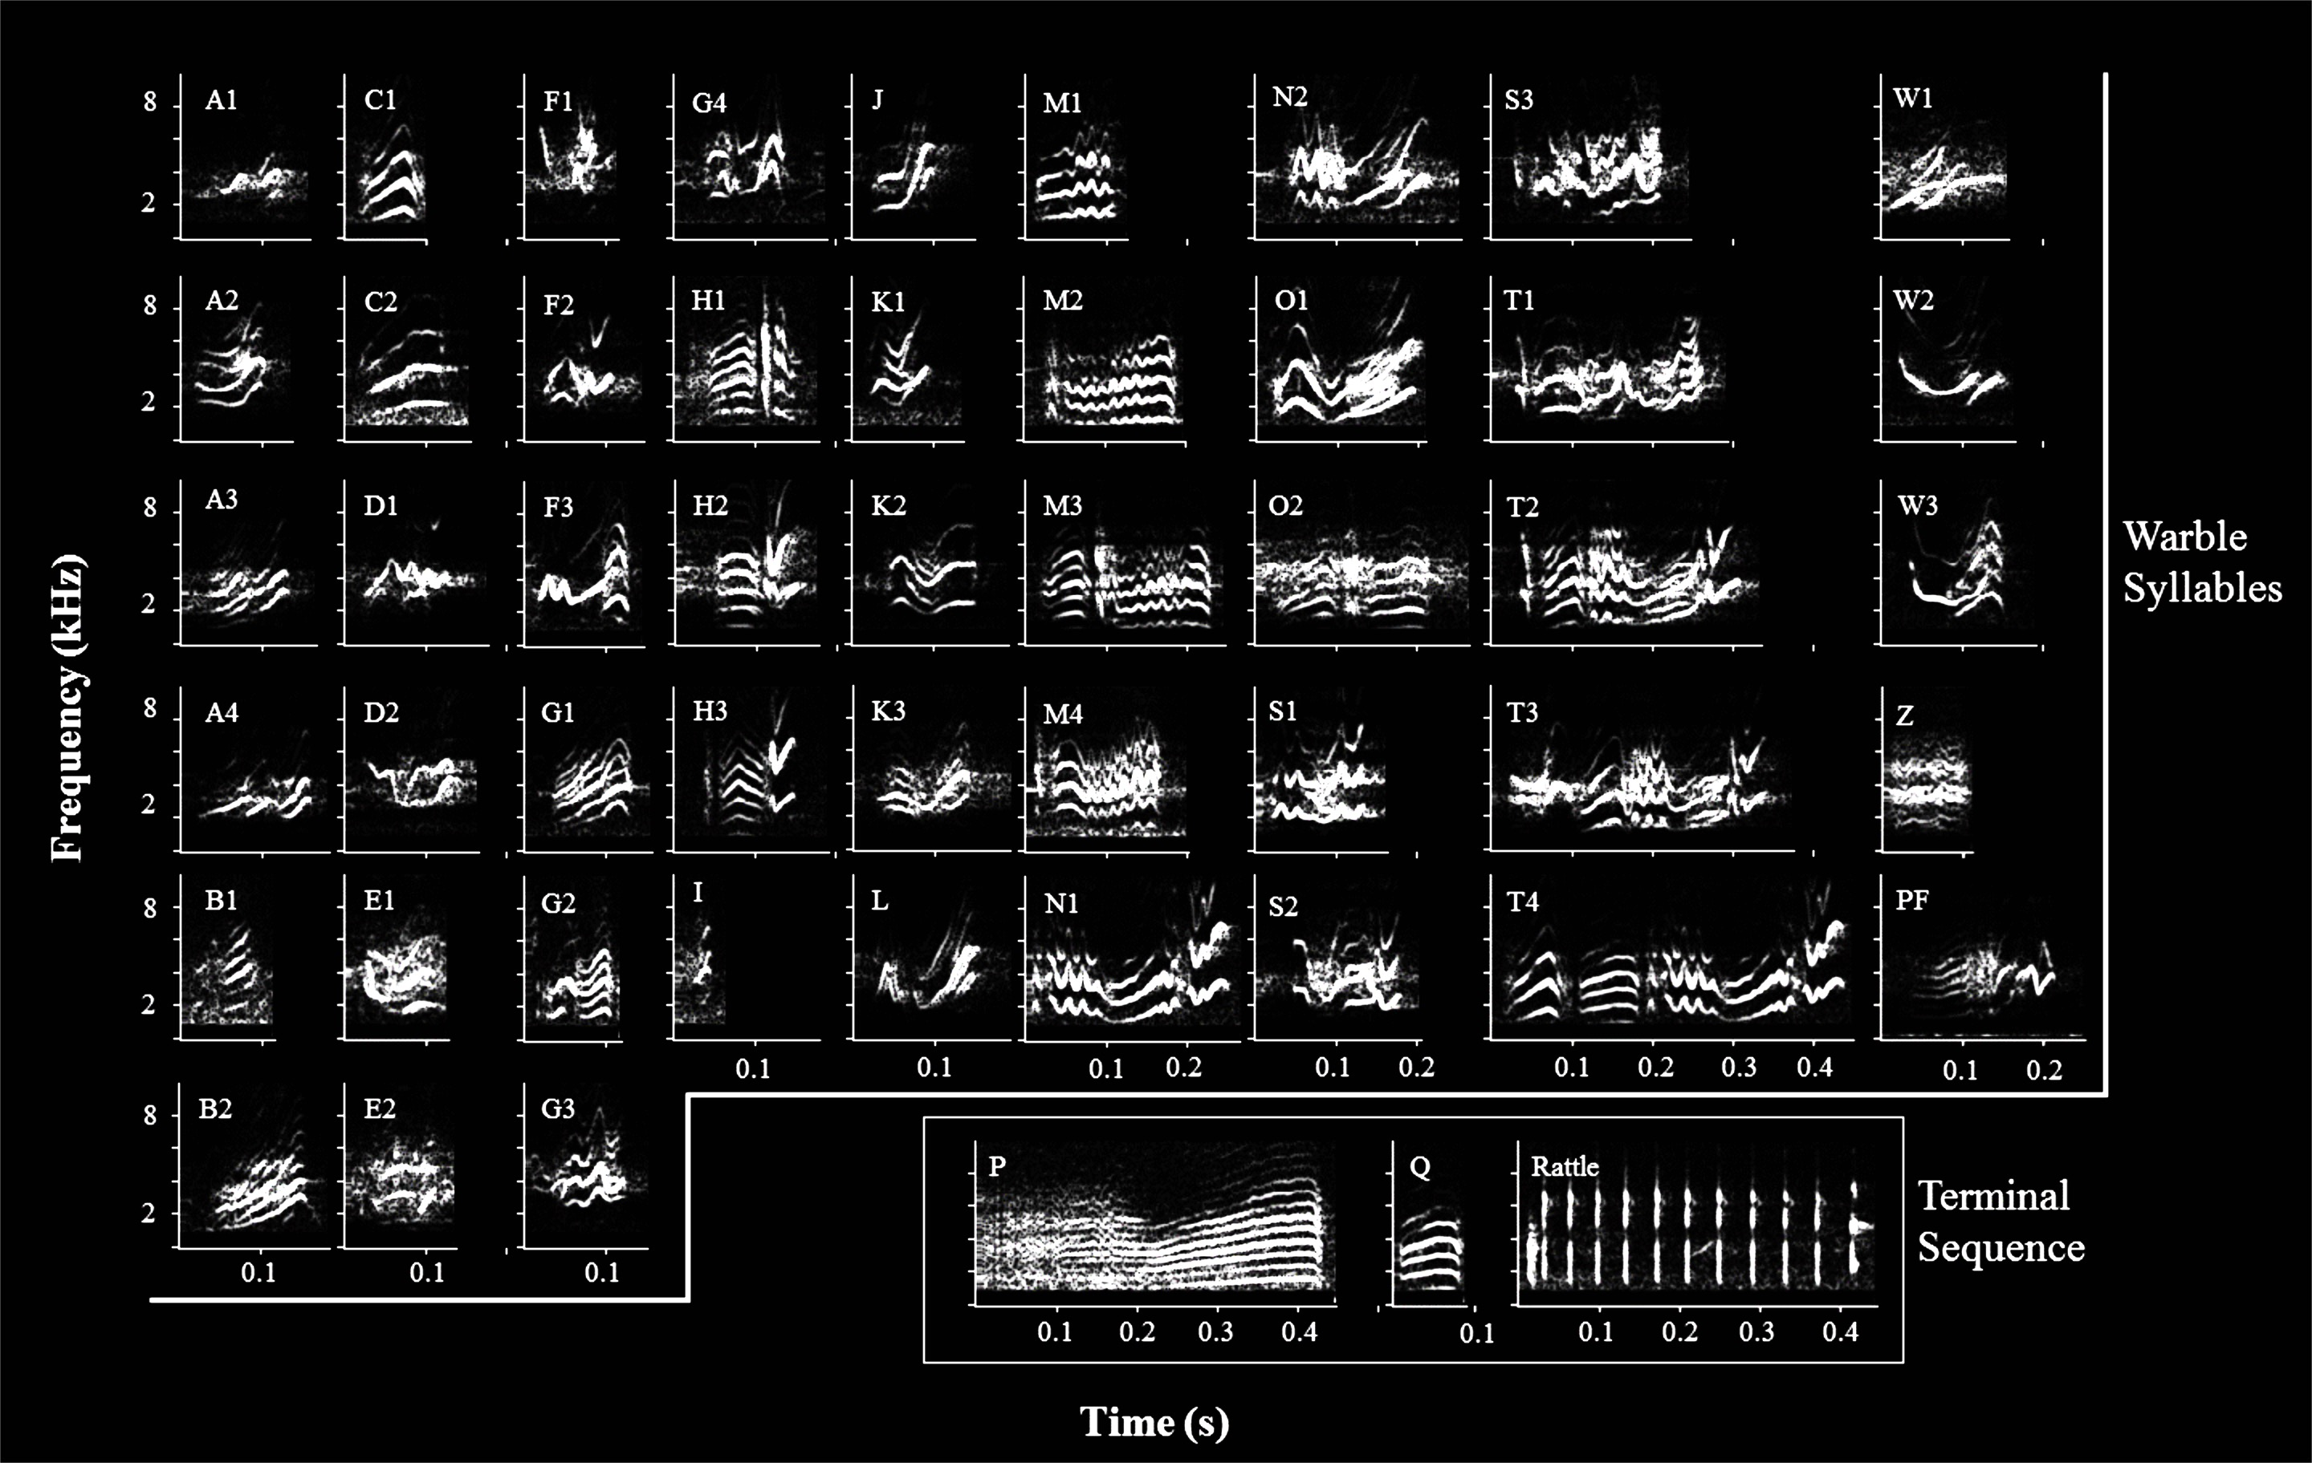
Syllable Repertoire
Syllable Repertoire
Notes:
These are example syllables; 51 syllables

Slide 27
Simple
Syllable Repertoire
Complex
Complex
Intermediate
Intermediate
Syllable Repertoire
Notes:
51 syllables

Slide 28
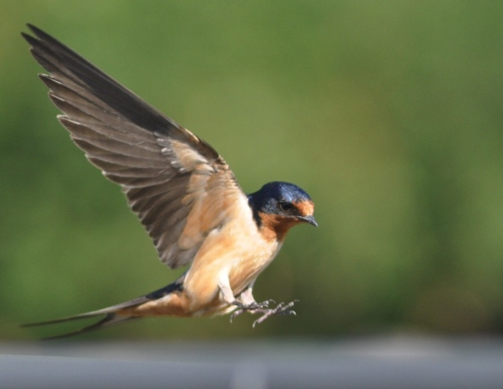
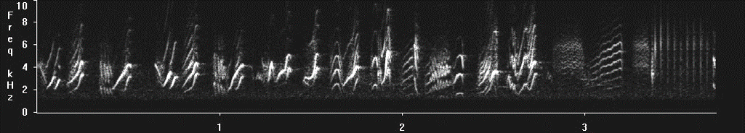
Measured 28 traits
Morphology
Color
Song
Frequency
Temporal
Repertoire
N= 50 males

Slide 29
Trait Correlation Matrix
 | WL | PL | RL | PF W | PF P | PF CR | WE W | FB CR | RTmp | STmp | %A | %S | %T | Rep | RWL | TS | T Bri | T Hue | T Chr | R Bri | R Hue | R Chr | B Bri | B Hue | B Chr | V Bri | V Hue | V Chr
WL | 0
PL | 0.02 | 0
RL | 0.02 | 0.12 | 0
PF W | 0.27 | 0.13 | -0.04 | 0
PF P | -0.13 | 0.19 | -0.15 | 0.43 | 0
PF CR | -0.37 | 0.18 | -0.18 | 0.23 | 0.33 | 0
WE W | 0.01 | -0.03 | -0.08 | 0.45 | 0.36 | 0.43 | 0
FB CR | 0.12 | -0.08 | 0.05 | -0.36 | -0.51 | -0.40 | -0.12 | 0
RTmp | 0.23 | 0.08 | -0.41 | 0.04 | 0.00 | -0.14 | -0.13 | 0.22 | 0
STmp | 0.29 | 0.03 | -0.32 | 0.15 | -0.08 | -0.02 | -0.01 | 0.15 | 0.55 | 0
%A | 0.41 | -0.07 | 0.03 | 0.16 | -0.21 | -0.42 | -0.06 | 0.17 | 0.15 | 0.37 | 0
%S | 0.09 | 0.17 | 0.01 | 0.23 | 0.32 | 0.43 | 0.33 | -0.24 | -0.28 | -0.07 | -0.36 | 0
%T | 0.05 | -0.07 | 0.16 | 0.00 | -0.08 | -0.04 | -0.12 | -0.02 | -0.04 | -0.09 | -0.18 | 0.10 | 0
Rep | 0.21 | -0.09 | -0.05 | 0.06 | 0.05 | 0.08 | 0.16 | -0.14 | 0.00 | 0.16 | 0.13 | 0.16 | 0.04 | 0
RWL | 0.21 | -0.10 | -0.04 | -0.10 | -0.19 | -0.10 | -0.11 | -0.07 | 0.19 | 0.15 | 0.12 | -0.25 | 0.22 | 0.09 | 0
TS | 0.29 | -0.22 | 0.06 | -0.02 | -0.27 | 0.13 | 0.07 | -0.03 | 0.03 | 0.08 | -0.01 | -0.07 | 0.36 | 0.10 | 0.51 | 0
T Bri | -0.25 | 0.26 | 0.19 | 0.02 | 0.28 | 0.17 | -0.01 | -0.18 | -0.11 | -0.28 | -0.24 | -0.07 | 0.19 | 0.03 | 0.07 | -0.12 | 0
T Hue | 0.16 | 0.05 | -0.10 | -0.07 | 0.07 | -0.19 | -0.05 | 0.17 | 0.14 | 0.01 | 0.12 | 0.13 | -0.10 | -0.23 | -0.15 | 0.01 | -0.61 | 0
T Chr | 0.19 | -0.17 | -0.16 | -0.12 | -0.32 | -0.27 | -0.05 | 0.28 | 0.17 | 0.27 | 0.25 | 0.07 | -0.26 | 0.03 | -0.07 | 0.00 | -0.78 | 0.49 | 0
R Bri | -0.28 | 0.10 | 0.15 | 0.16 | 0.11 | 0.23 | 0.10 | 0.04 | -0.16 | -0.22 | -0.12 | -0.19 | -0.13 | 0.02 | -0.03 | -0.01 | 0.52 | -0.35 | -0.34 | 0
R Hue | -0.07 | 0.09 | -0.04 | -0.24 | -0.28 | -0.12 | -0.09 | 0.29 | 0.16 | 0.14 | 0.12 | -0.07 | -0.03 | -0.10 | 0.01 | 0.11 | -0.20 | 0.27 | 0.17 | -0.23 | 0
R Chr | 0.29 | -0.08 | 0.00 | -0.13 | -0.23 | -0.14 | -0.04 | -0.06 | -0.01 | 0.17 | 0.21 | 0.24 | 0.07 | 0.07 | 0.04 | 0.08 | -0.59 | 0.35 | 0.50 | -0.85 | 0.18 | 0
B Bri | -0.20 | 0.22 | 0.14 | 0.29 | 0.47 | 0.29 | 0.34 | -0.08 | -0.11 | -0.12 | -0.15 | 0.09 | -0.02 | 0.06 | -0.01 | -0.23 | 0.62 | -0.30 | -0.46 | 0.65 | -0.31 | -0.57 | 0
B Hue | -0.02 | 0.16 | 0.18 | -0.23 | -0.15 | 0.07 | -0.02 | 0.14 | 0.12 | -0.12 | 0.01 | -0.17 | -0.10 | -0.05 | 0.14 | 0.17 | 0.15 | -0.01 | -0.14 | 0.00 | 0.41 | -0.09 | -0.18 | 0
B Chr | 0.32 | -0.17 | -0.06 | -0.22 | -0.47 | -0.32 | -0.29 | 0.05 | 0.02 | 0.09 | 0.17 | -0.06 | 0.10 | -0.05 | 0.05 | 0.28 | -0.60 | 0.30 | 0.41 | -0.64 | 0.26 | 0.60 | -0.95 | 0.13 | 0
V Bri | -0.30 | 0.10 | 0.23 | 0.15 | 0.27 | 0.21 | 0.03 | -0.01 | -0.17 | -0.28 | -0.19 | -0.05 | 0.16 | -0.24 | 0.08 | 0.12 | 0.39 | -0.13 | -0.41 | 0.53 | -0.18 | -0.53 | 0.47 | 0.06 | -0.42 | 0
V Hue | 0.24 | 0.19 | 0.03 | 0.02 | -0.26 | -0.08 | -0.08 | -0.07 | 0.07 | 0.28 | 0.19 | -0.10 | -0.22 | 0.07 | 0.31 | 0.07 | -0.01 | -0.05 | 0.11 | -0.04 | 0.25 | 0.10 | -0.13 | 0.21 | 0.15 | -0.39 | 0
V Chr | 0.34 | -0.09 | -0.23 | -0.02 | -0.33 | -0.19 | 0.05 | 0.03 | 0.17 | 0.23 | 0.22 | -0.01 | -0.35 | 0.24 | -0.04 | -0.05 | -0.42 | 0.08 | 0.43 | -0.32 | 0.18 | 0.36 | -0.41 | -0.06 | 0.42 | -0.85 | 0.40 | 0
Notes:
378 Pairwise comparisons;
Spearman rank correlations
from this—patterns are not super straightforward

Slide 30


Multimodal Barn Swallow Phenotype Network
Notes:
Tail Streamer and Wing Length are tightly correlated, as they both likely share a similar developmental or genetic basis

Slide 31
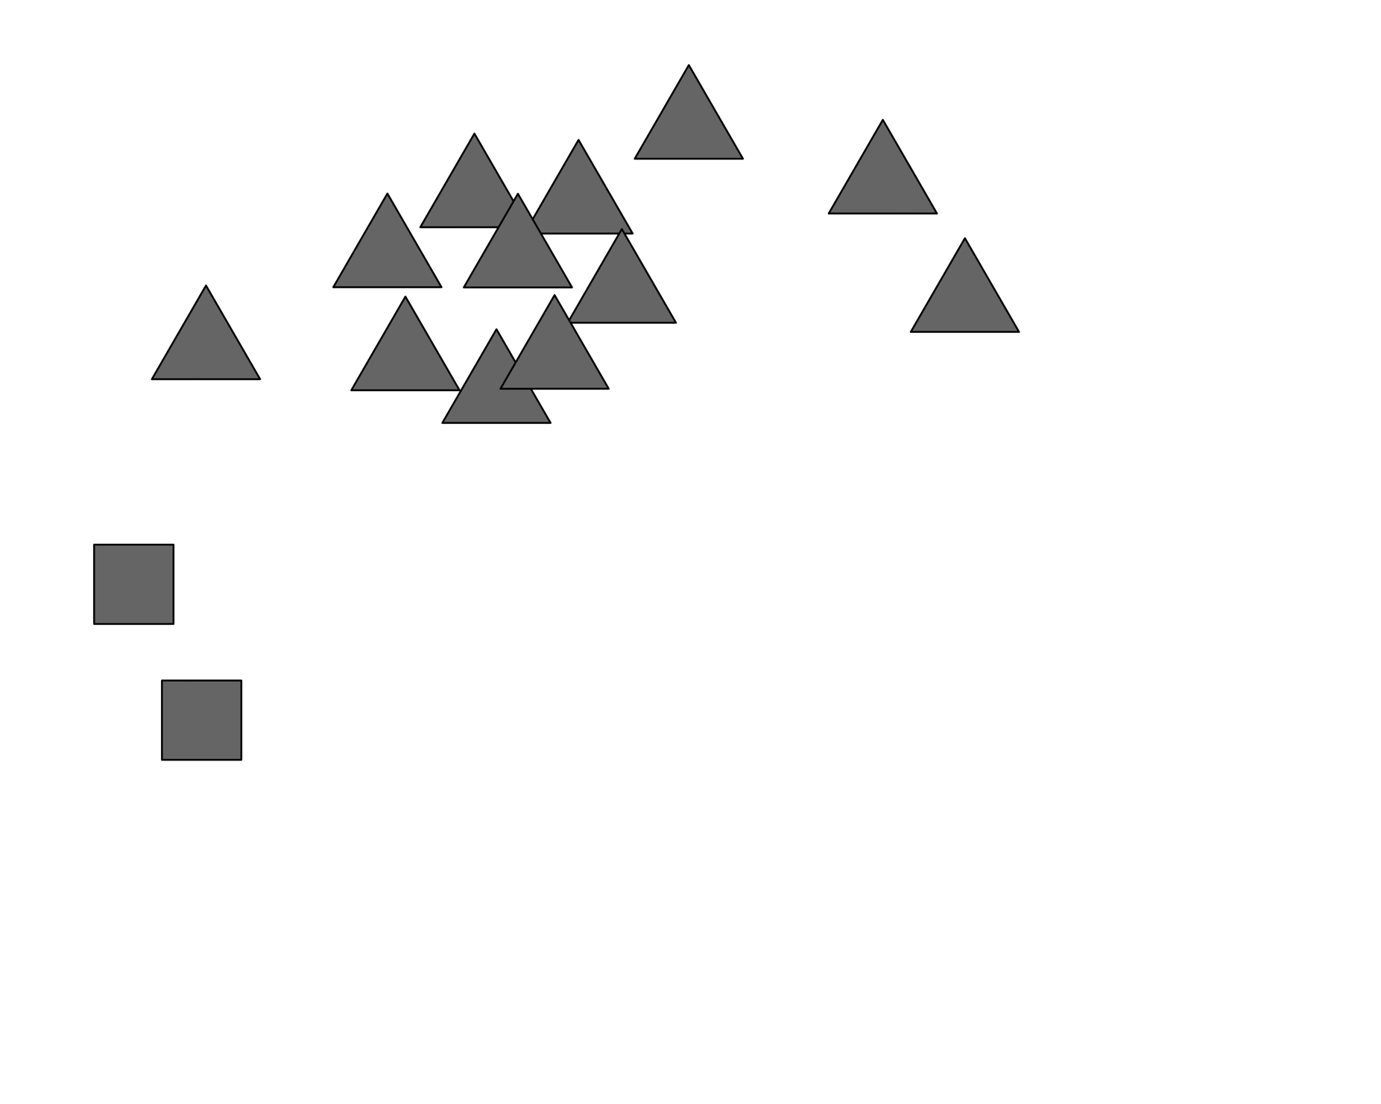

Multimodal Barn Swallow Phenotype Network
Notes:
A note about reading these figures
Thicker lines mean stronger relationships between traits. Each shape (node) is a different trait.
Nodes are distributed to minimize edge crossings
Although color module is fully connected, some aspects of color are more strongly related than others
In particular, these triangles are weakly correlated

Slide 32
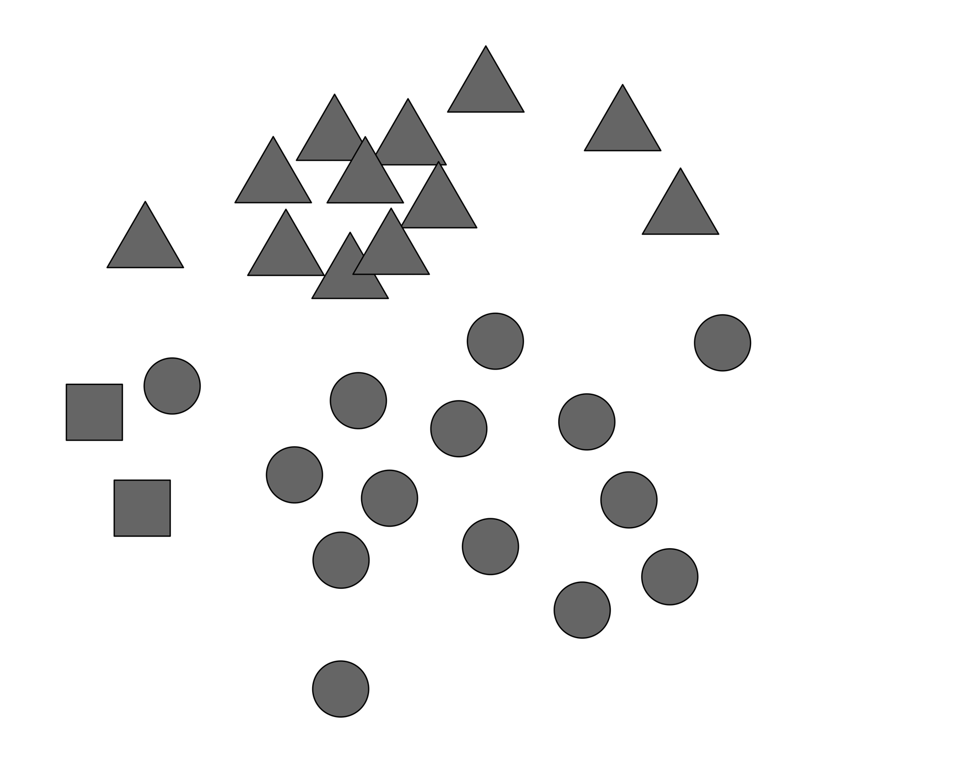

Multimodal Barn Swallow Phenotype Network
Notes:
Song traits are distributed throughout the network
Some more closely related to color and morph than to other song traits
Many connections between main color cluster and these song nodes here
And two isolated song nodes uncorrelated with any other aspect of phenotype

Slide 33

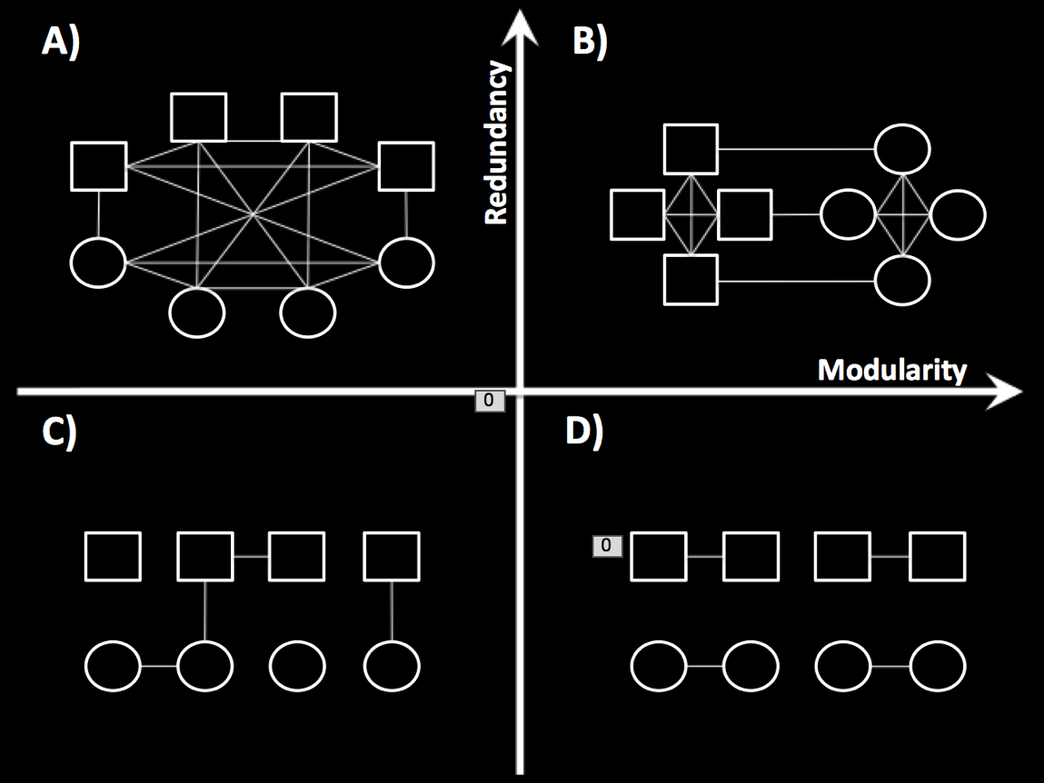
Network Architecture
Notes:
Balance of redundancy and modularity
Not alternatives.
Allows both backup signaling and transfer of multiple messages
More comparative work is necessary to determine how general this finding is.

Slide 34
Trait Functions
(In Competition vs Mate Choice)
Notes:
Now that we’ve learned something about the overall structure of the signaling system,
We can gain further insight by mapping functional data back onto the network.
To do this we determined which traits predicted success in a competitive versus a mating context.

Slide 35
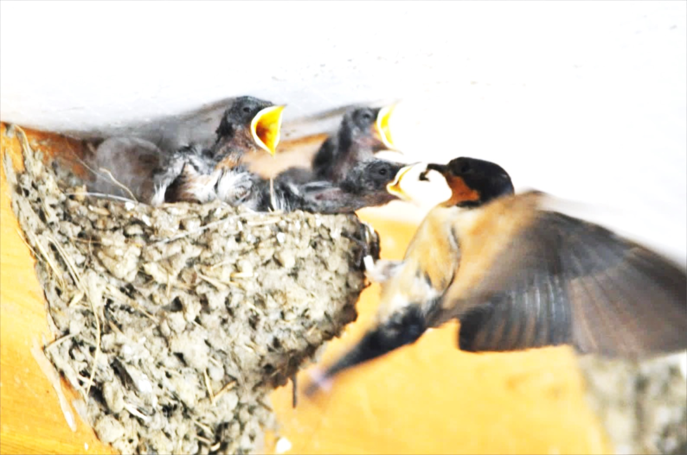
Sexual Selection:
Female Choice
% Genetic Offspring
Trait Measurement
Notes:
as a measure of female choice, we used %genetic offspring in a nest.
This is a valid metric of choice, as experimental manipulation of male phenotype has been shown to affect paternity in subsequent broods.
Using an AIC-information theoretic approach for model selection, we determined which traits were important in predicting proportion of genetic offspring.

Slide 36
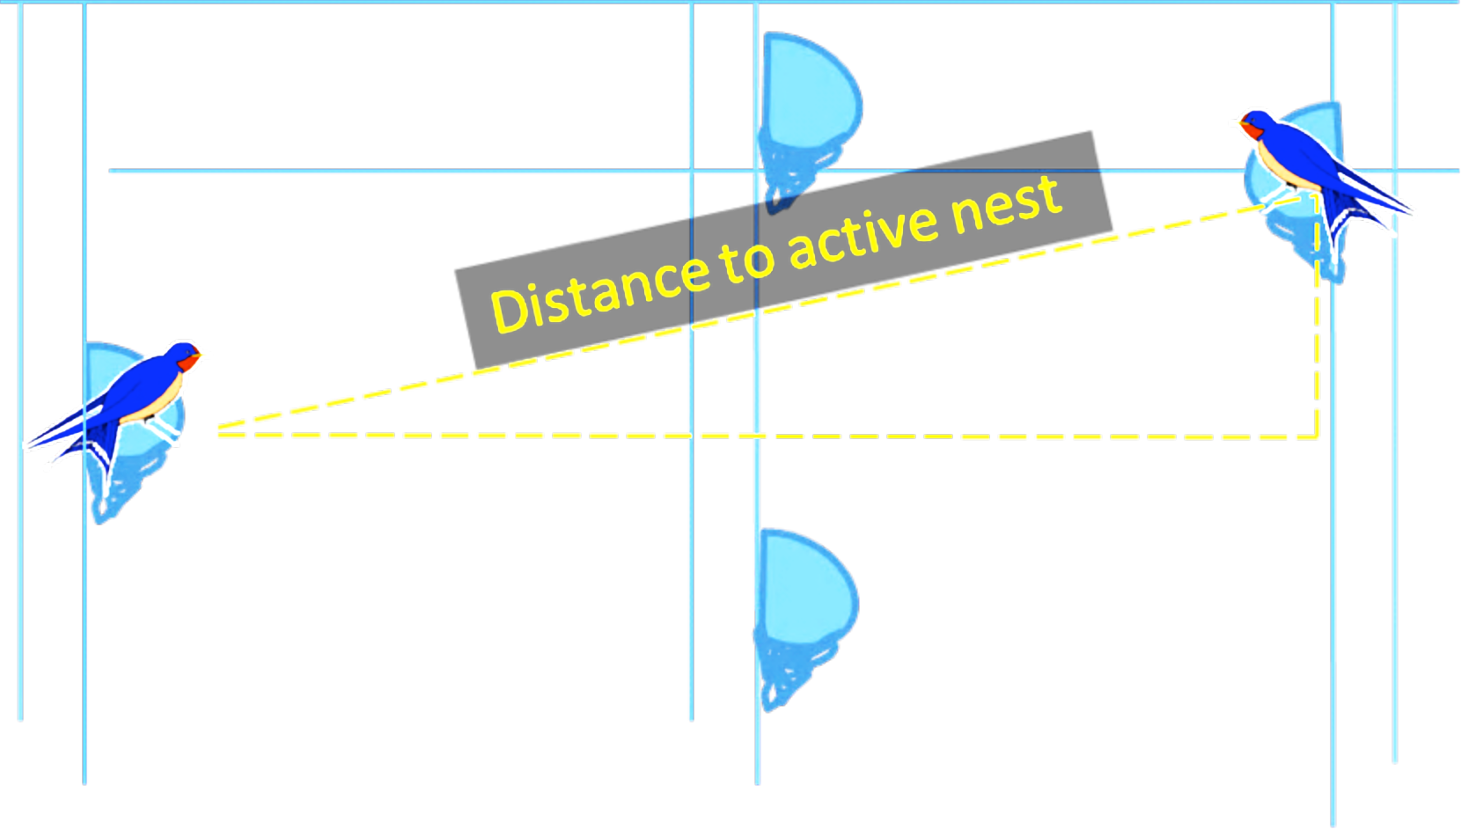
Sexual Selection:
Male-Male Competition
Competitor Distance
Trait Measurement
Notes:
To infer which traits were important in male-male competition, we used nearest competitor distance. This is the linear distance to the nearest competing male with a fertile female.
Barn swallows have been shown to maximize nest distance within structures and prefer nests out of sight of neighbors.
Testosterone has also been shown to correlate with number of active neighbors
So we believe this is an appropriate measure of intrasexual competition, with more dominant males maintaining a larger distance from competitors

Slide 37
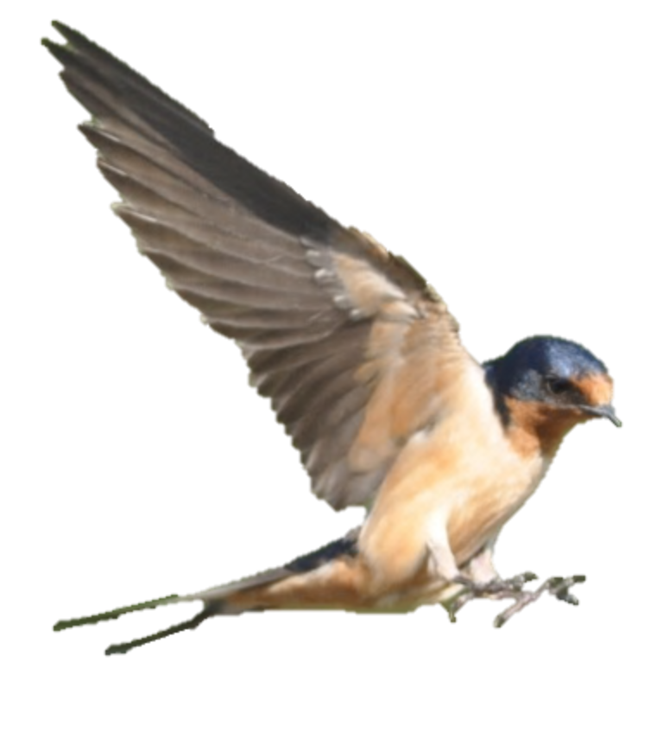
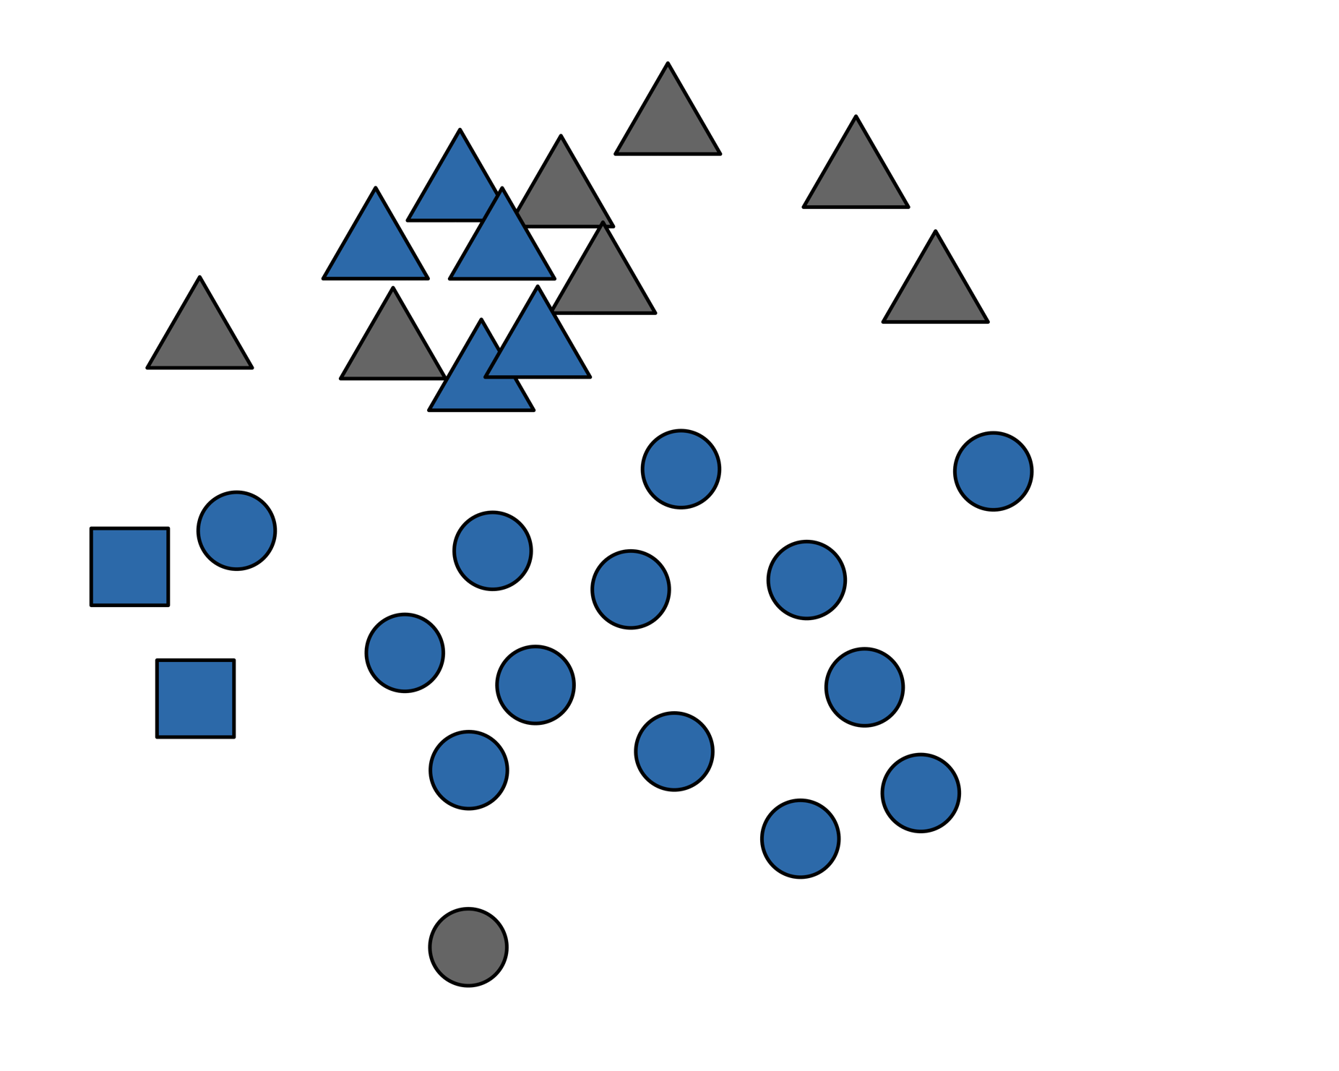

Trait Functions
Morphology
Color
Song
Female Choice
NONE
Notes:
Large portion of the network seems to be utilized for female choice
Not surprising that color is important
Wing length and tail streamers increase w/ age.
Experimentally shown tail streamers are not preferred, so b/c these traits
Incr over time, this cluster of traits may be indicators of age

Slide 38
Trait Functions
Morphology
Color
Song
Female Choice
NONE
Notes:
All song traits except one important in mate choice
Collectively, fems use a combo of traits which may convey
Different info about age, quality, or motivation over different devo timescales
To choose their mates

Slide 39
Trait Functions
Morphology
Color
Song

Slide 40
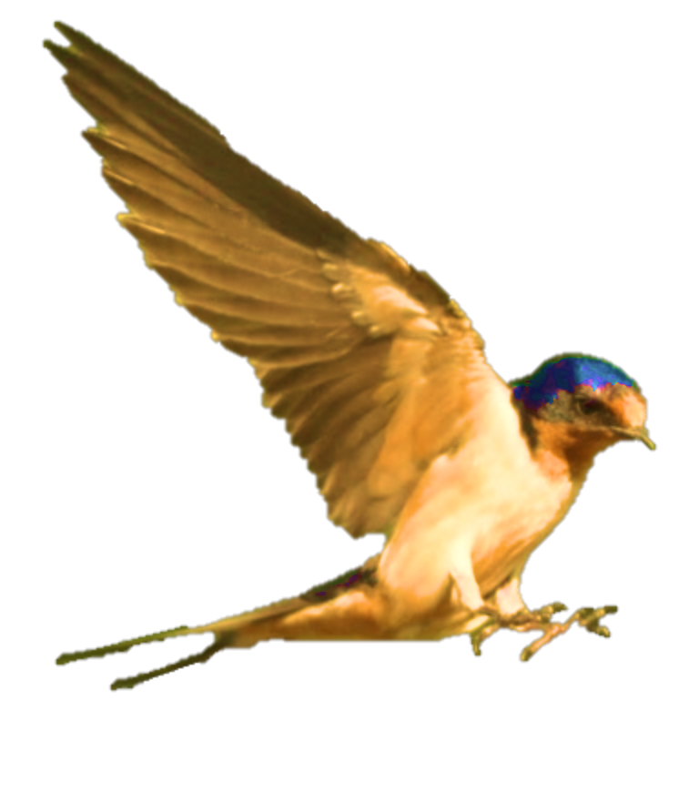

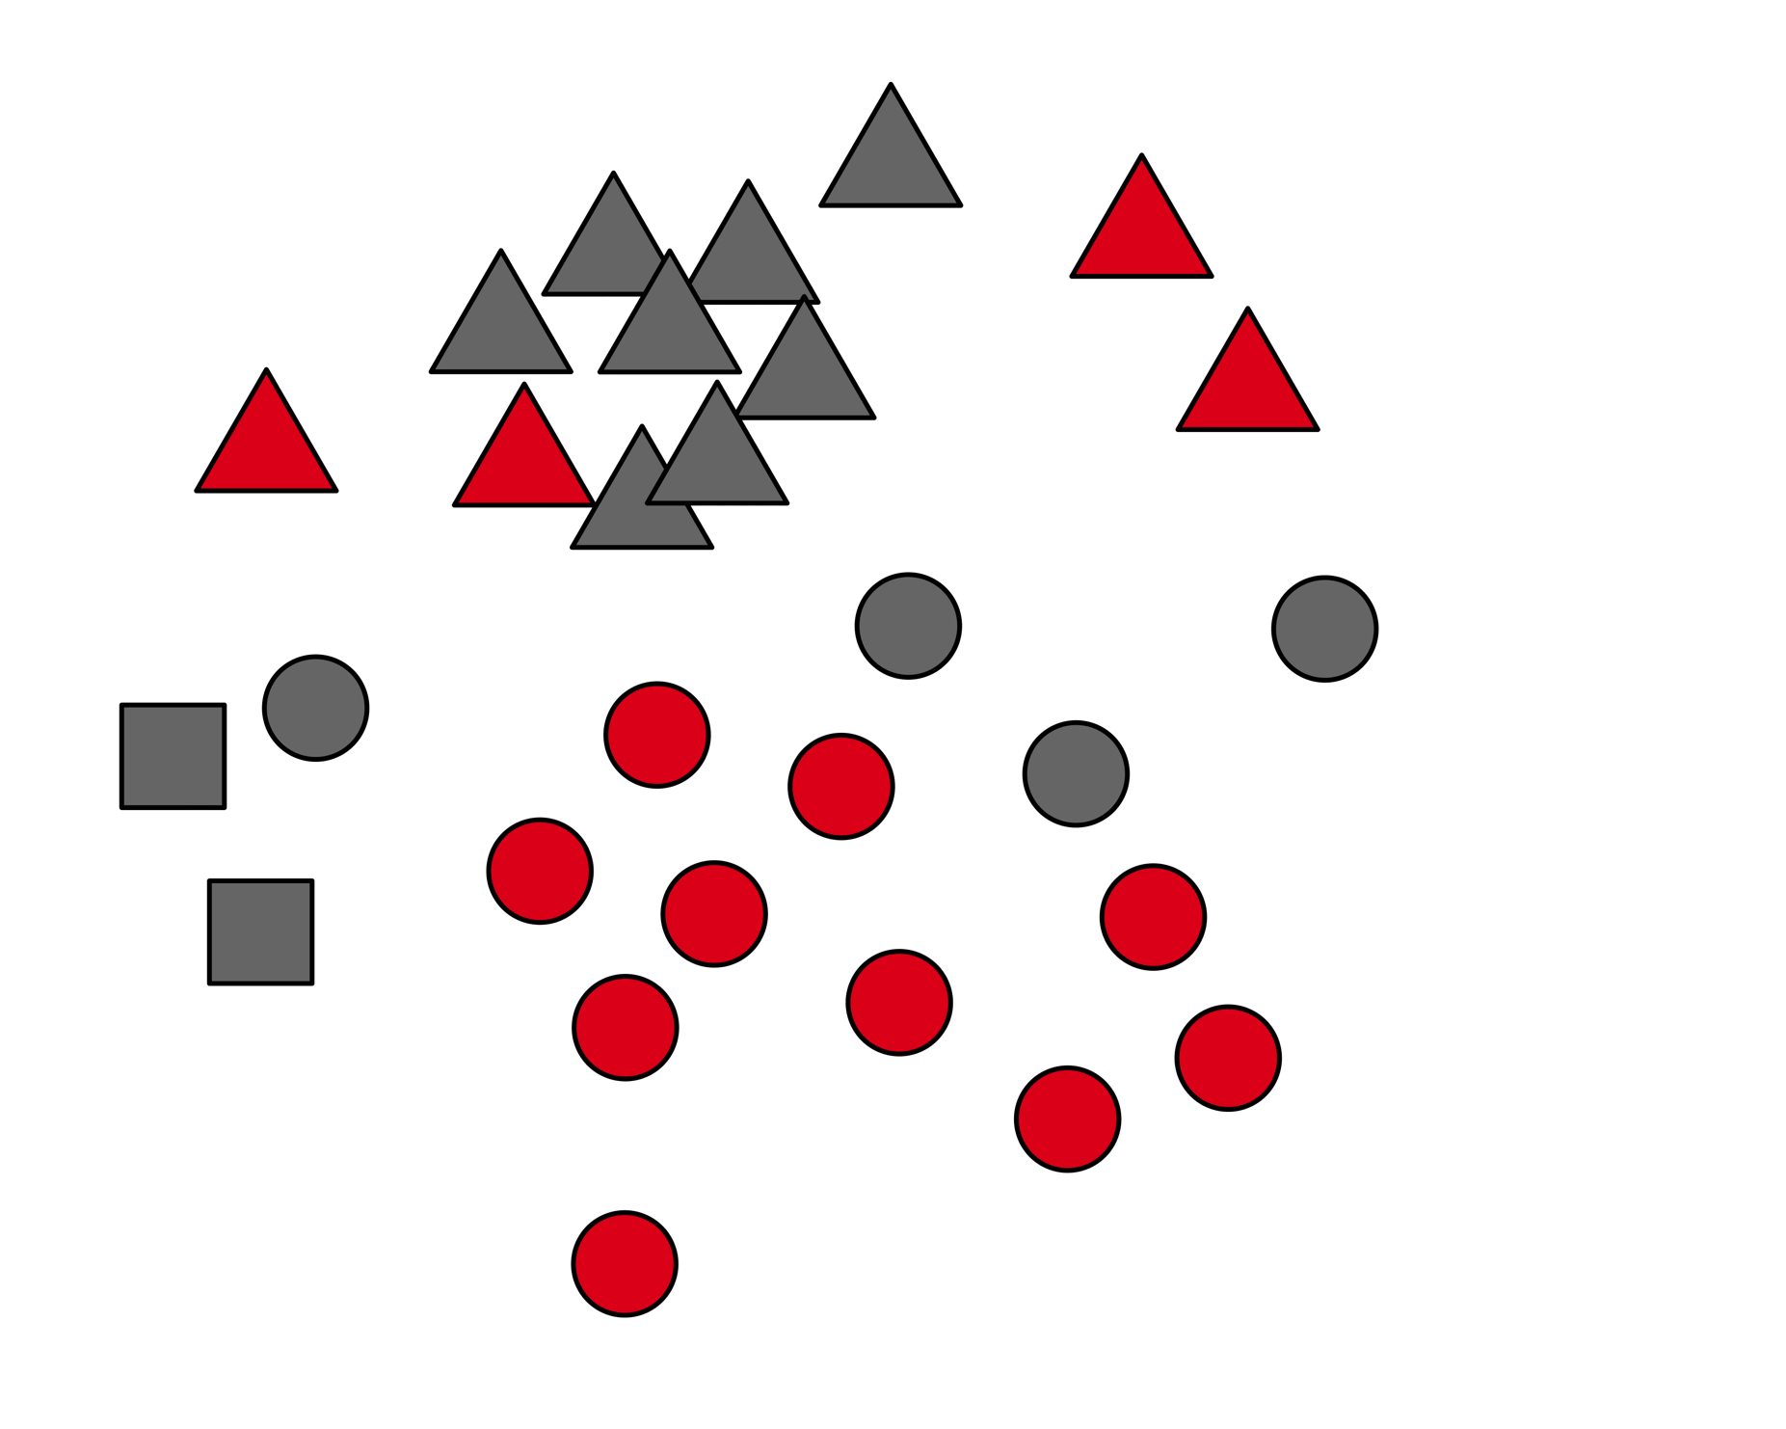
Trait Functions
Morphology
Color
Song
Competition
Competition
NONE
Notes:
Interesting that vent, breast, and belly hue
are important in competition, not paternity
Offers possibility that the weak correlations between hue and other axes of color
Are explained by their utilization in different sexual signaling contexts

Slide 41
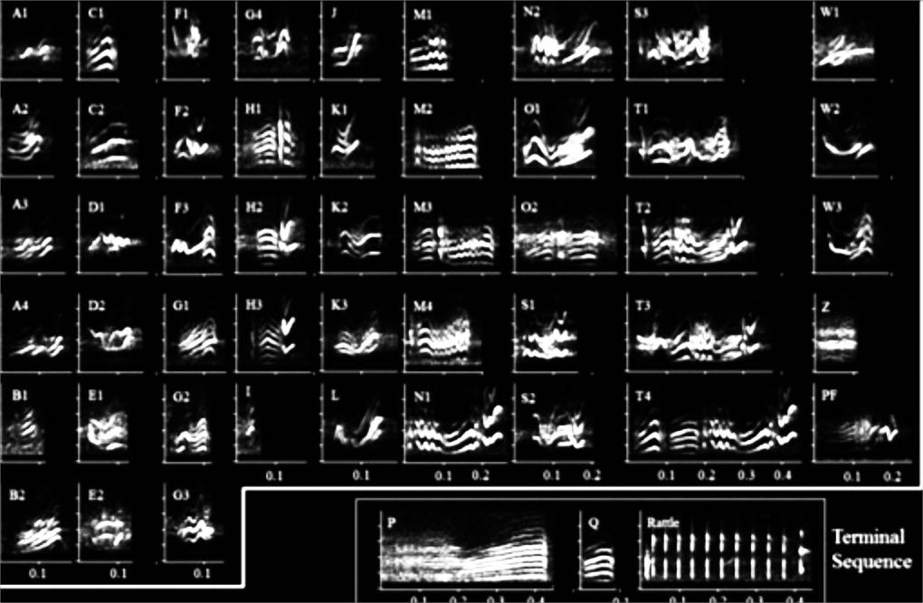
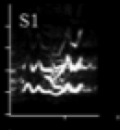
Trait Functions
Morphology
Color
Song
Competition
Competition
NONE
Notes:
A number of song traits were also important in competition
Pitch; timing of the warble and rattle; proportion of S syllables
And also the overall repertoire size.
This was actually the best predictor of competitor distance and
Adds to growing evidence across birds that repertoire size is not the result of female choice.

Slide 42
Trait Functions
Morphology
Color
Song

Slide 43
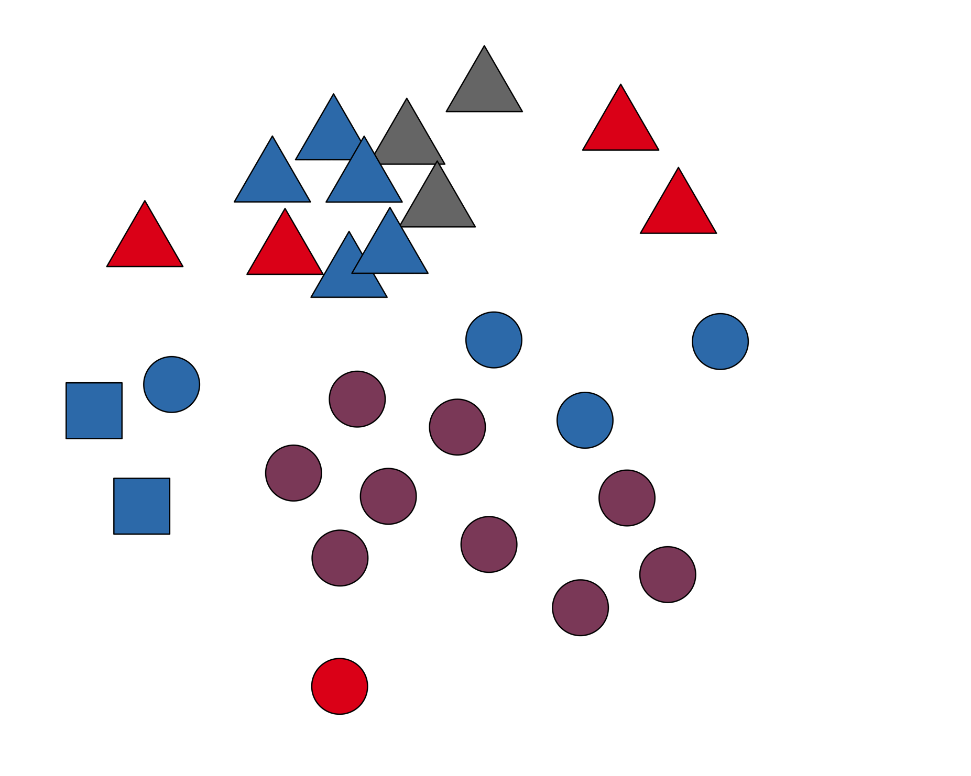
Trait Functions
Morphology
Color
Song
Female Choice
Female Choice & Competition
Competition
NONE
Wilkins et al, Proc B 2015
Notes:
Mapping both contexts onto the network:
Interesting that overall pitch and timing of the song were really the only traits important across contexts
Makes sense, as these traits can be quickly assessed
And very concisely convey motivation of potential mates and competitors

Slide 44
This figure provides:
Morphology
Color
A glimpse at the communication system
Fodder for hypotheses on:
Information content
How selection relates to trait architecture
Info for designing experiments to test:
Functional redundancy
Trait interactions
Song
Female Choice
Female Choice & Competition
Competition
NONE
Wilkins et al, Proc B 2015
Notes:
Information content: age, developmental quality, or motivation

Slide 45
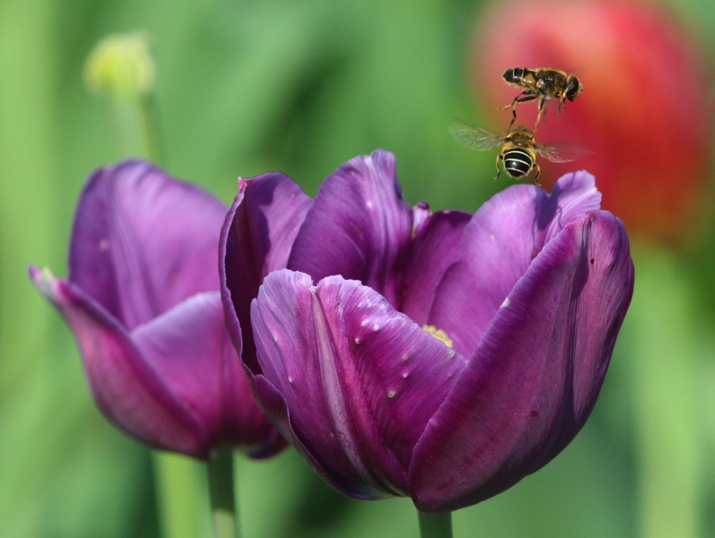
Network metrics can be applied to quantify system architecture
Applicable to any signaling system
Offers a unifying framework for the study of complex communication systems
Matt Wilkins
Notes:
Network metrics:
Redundancy=Average correlation strength
Modularity=Assortativity by trait type
Can be used to compare network structure across closely related species
Flowers: olfactory boquets, colors, pollen or nectar rewards, which may be important
For attracting different pollinator guilds

Slide 46
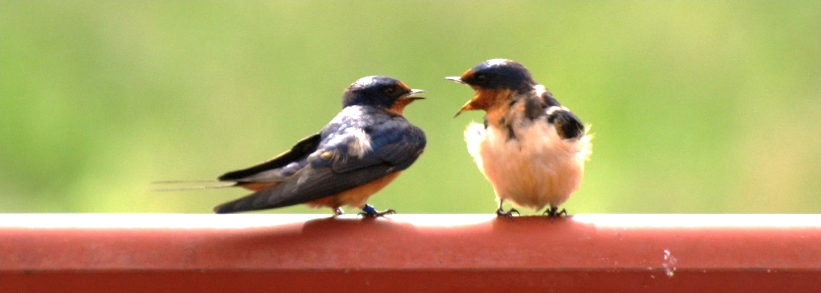
Take Home
Matt Wilkins
Phenotype networks offer many advantages
Our Study:
Males and females use different signals
Exceptions: a few dynamic song traits
Notes:
Advantages: visualizing complex data; generating and testing hypotheses
Our study:
M and F diff sigs: provide info over different timescales
Dynamic song traits: provide instantaneous info on motivation of potential mates and rivals
First evidence for how different modes of selection affect evolution of communication systems as a whole

Slide 47
Comparing phenotype networks

Slide 48
Phenotype Networks
Wilkins et al, Proc B 2015
Notes:
We recently proposed phenotype networks as a tool for visualizing such trait correlations to generate hypotheses
And also provide common metrics for comparing across systems
The work I’ll describe today extends this approach to a comparative framework
To look at differences in signaling architecture across populations

Slide 49






How do we describe population differences?
Length
Body color
Venom composition
Resemblance to a chair
Typically think about mean differences
Also important differences in trait correlations
Notes:
So, as we all know, there are all kinds of animals! (As you can see from this diversity slide of nocturnal animals during a lunar eclipse)
Before we can understand the drivers of this diversity—1st ask how do we even describe pop. diffs?
Let’s take a common study species at this conference—Say, COBRAS…1 pop that’s dark, one that’s lighter
Might describe things like Length…
Typically focus on diffs in avg traits…Perhaps of equal importance to think about trait corrs.
e.g. Here, darker snakes tend to be larger.

Slide 50
8 Morphological Traits
Body Size
Mass
# Heads
Head Width
# Tentacles
# Moustaches
Tongue Length
# Spines
Notes:
Let’s think about 8 morph traits describing your critter of choice:
Body l, Mass, # vert, and so on

Slide 51
8 Morphological Traits
Notes:
Let’s represent these traits as squares (We’ll call these nodes, using network terminology)

Slide 52
Mass
Body Size
Notes:
Some traits, like Mass & Body Size are expected to strongly correlate w/ each other
We’ll represent this strong correlation w/ a connecting line—in network speak (EDGE)

Slide 53
Eye Color
Body Size
Notes:
These traits vary in how correlated they are.
So, for example,

Slide 54
How does selection affect the phenotype network?
Selection
Correlated Selection
Notes:
Selection may be constrained by system architecture and selection on one trait drags along all correlated traits
Pleiotropy

Slide 55
+ integration
Selection
- integration
Notes:
Alternatively, selection may favor divergence in system architecture
Weakly corr. traits could be favored to increase integration if all beneficial
OR, Selection should break down trait correlations if only 1 trait selected so
That trait can be exaggerated w/o investing in traits with no fitness value.
Divergent selection, correlated vs independent trait evo.

Slide 56
How does divergent sexual selection affect signaling system architecture?
Population 1
Population 2
Notes:
The conceptual figures I just showed are very broad and applicable to any taxon—here we’ll ask the more directed question…
How does...
That is, not only how do trait means differ

Slide 57
How does divergent sexual selection affect signaling system architecture?
Notes:
, but how do signal trait correlations vary across populations?

Slide 58
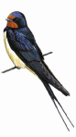
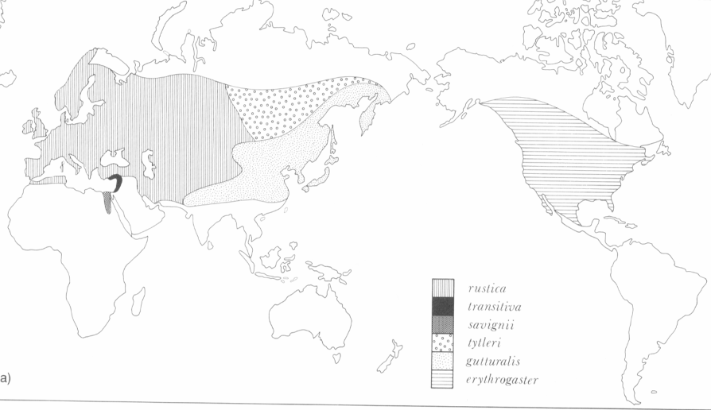
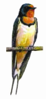
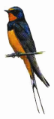
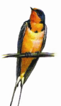
rustica
gutturalis
gutturalis
erythrogaster
transitiva
erythrogaster
Notes:
6 subspp distributed across Nor Hem. I’m showing 4 here.
There is pronounced variation in the amount of melanin pigments in breast plumage and the length of tail feathers.
Some populations very pale

Slide 59
rustica
gutturalis
gutturalis
erythrogaster
transitiva
erythrogaster
Notes:
Others very dark

Slide 60
rustica
gutturalis
gutturalis
erythrogaster
transitiva
erythrogaster
Notes:
Some have short tail feathers

Slide 61
rustica
gutturalis
gutturalis
erythrogaster
transitiva
erythrogaster
Notes:
Others very long tail feathers

Slide 62
rustica
gutturalis
transitiva
erythrogaster
Notes:
Mounting evidence that these diffs are result of divergent sexual selection pressures

Slide 63
rustica
transitiva
Notes:
Mounting evidence that these diffs are result of divergent sexual selection pressures

Slide 64
rustica
transitiva
Notes:
Recently did a selection analysis study showing that phenotypic divergence patterns
Correspond to differences in selection regimes

Slide 65
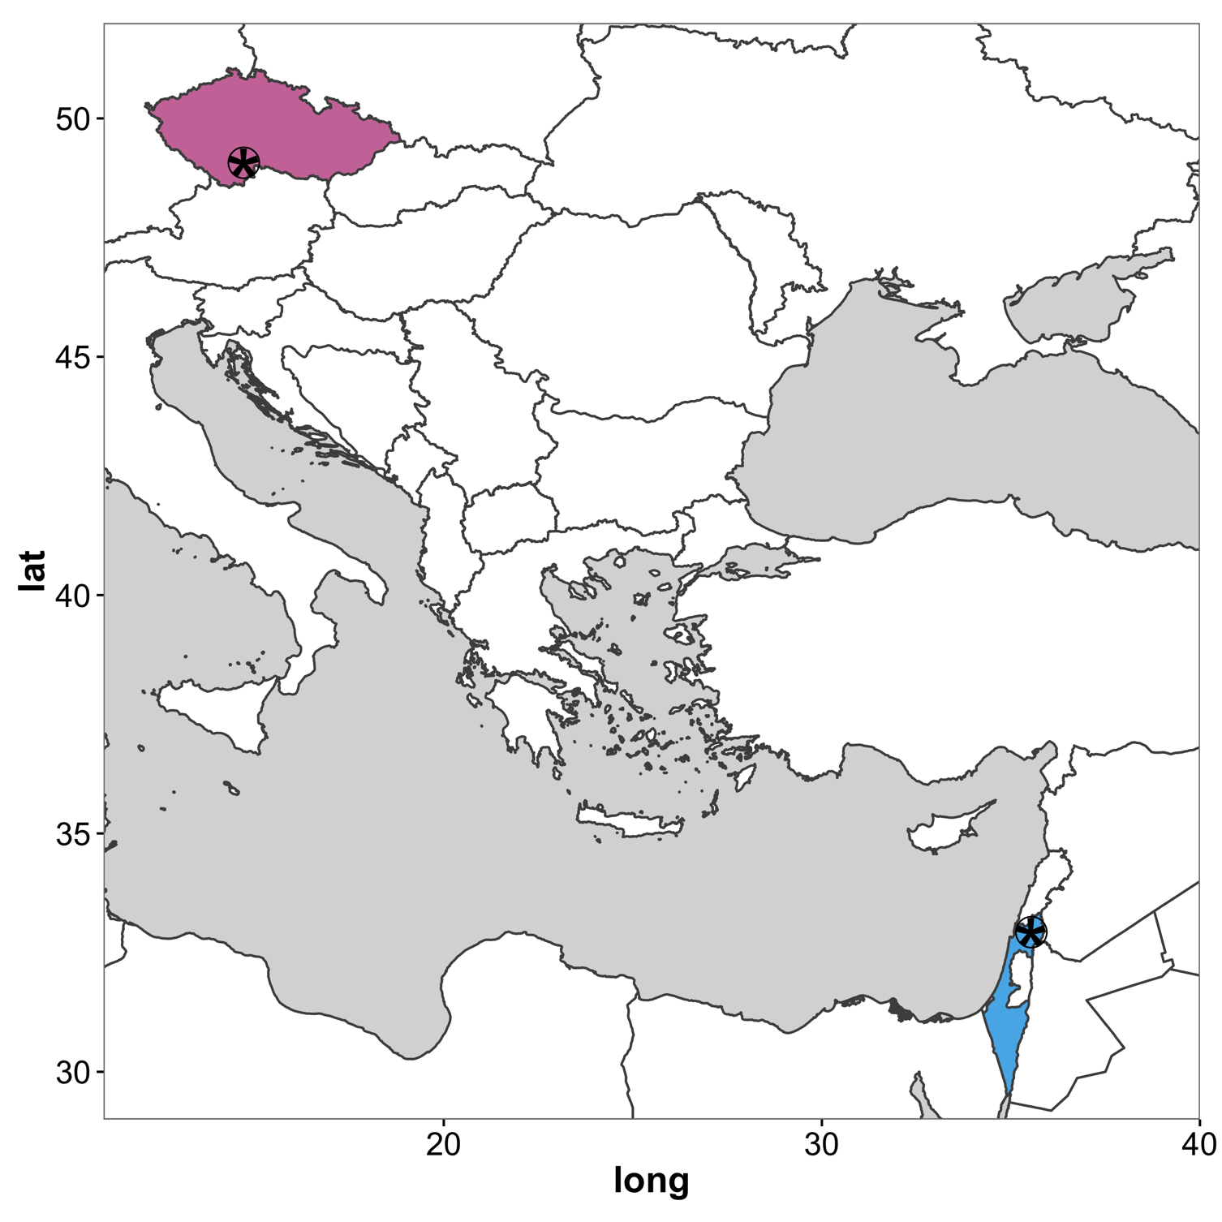
Czech Republic
rustica
Israel
transitiva
Wilkins, et al. J. Evo. Bio. (2017)
Notes:
Recently did a selection analysis study showing that phenotypic divergence patterns
Correspond to differences in selection regimes

Slide 66
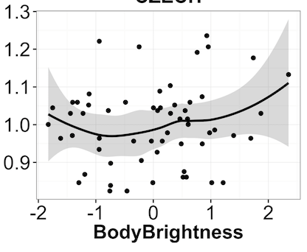
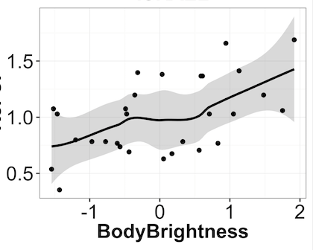
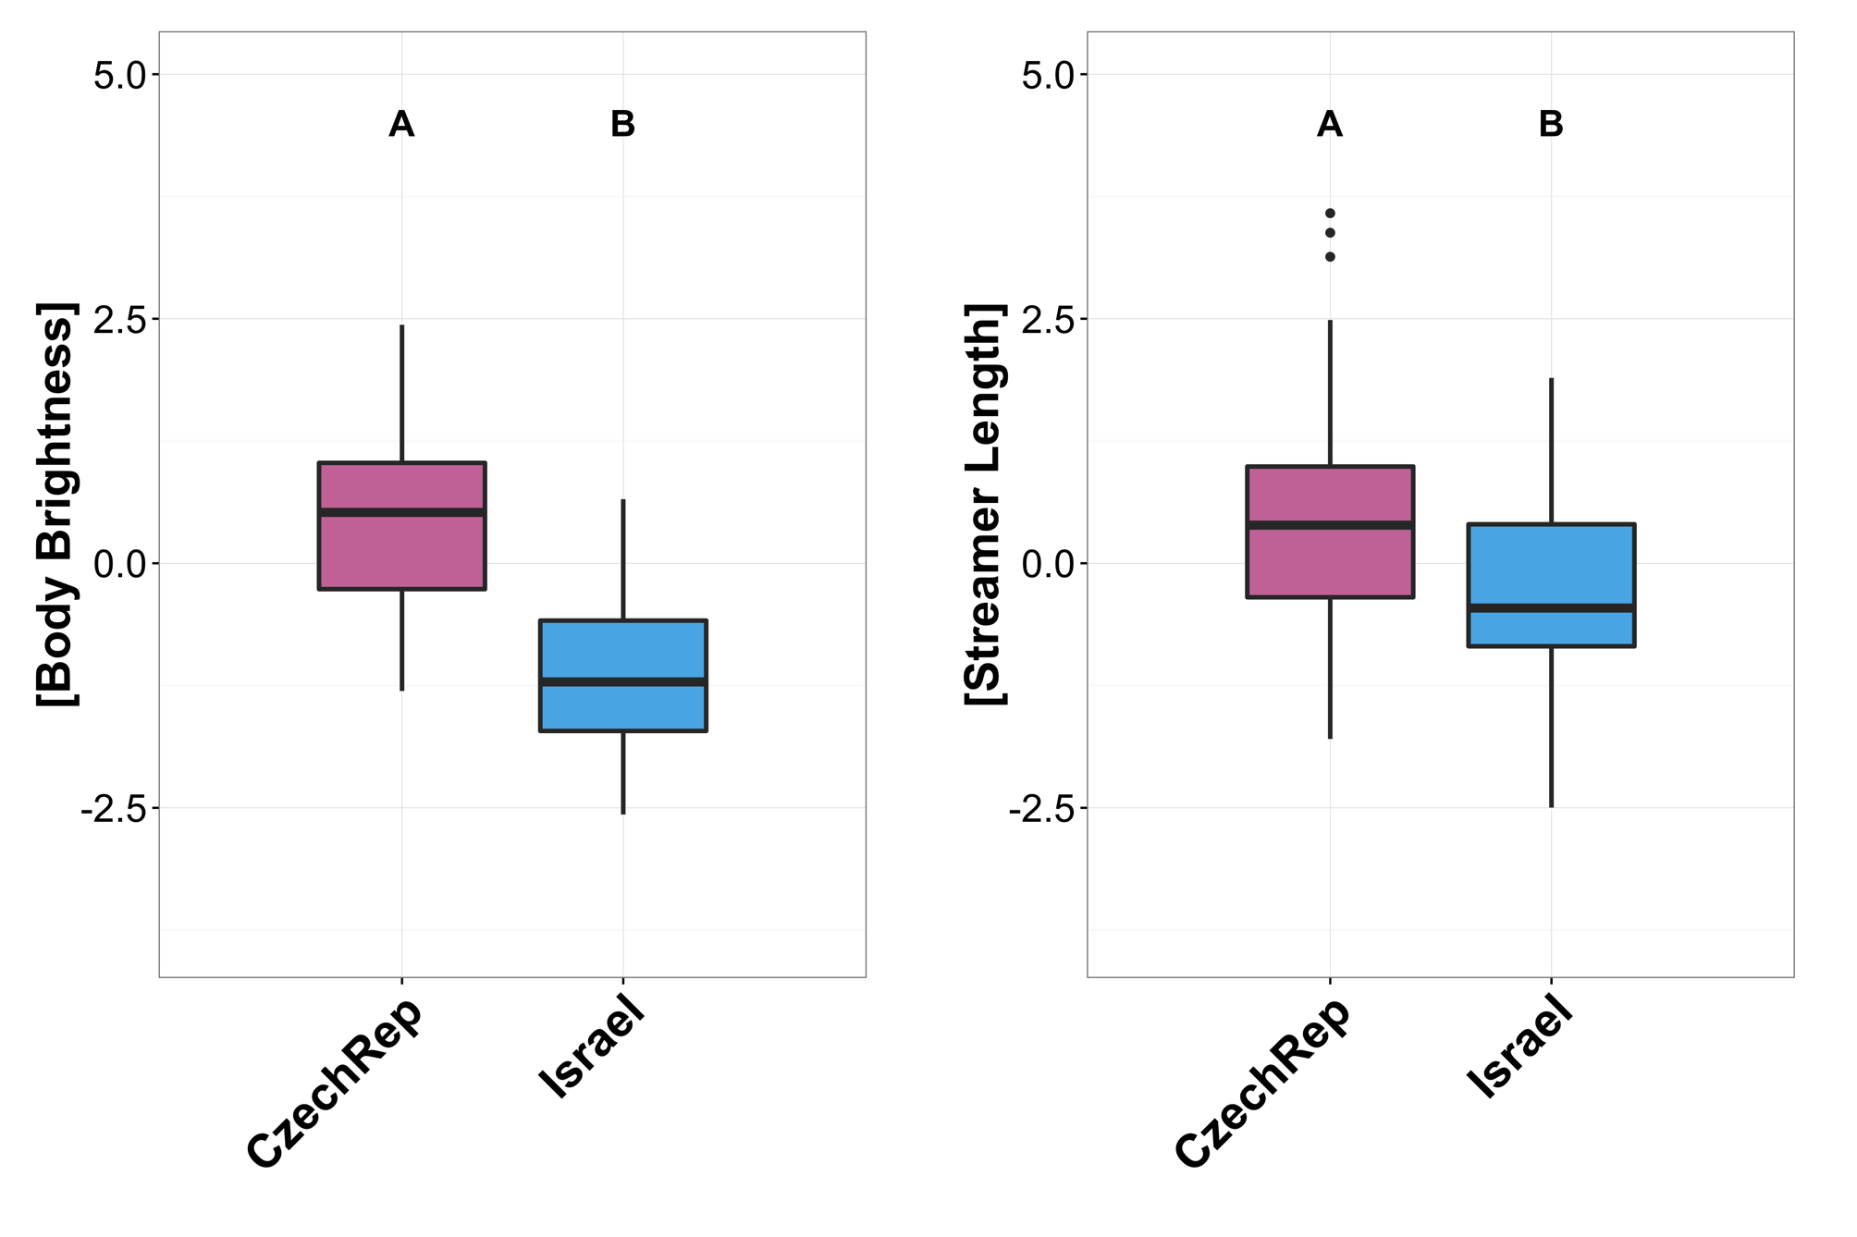
w
w
Selection→
Stabilizing
Directional
Wilkins, et al. J. Evo. Bio. (2017)
Notes:
Body Brightness was much higher in the CR than Israel
Evidence for stabilizing selection in CR
Directional selection favoring earlier breeding for dark males

Slide 67
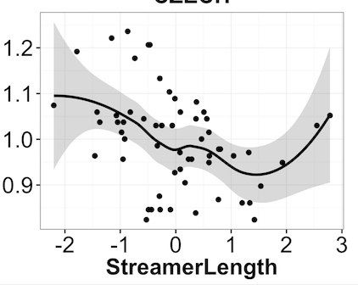
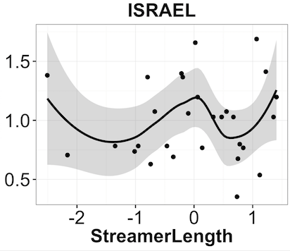
w
w
w
w
Selection→
Stabilizing
Directional
Directional
ø
Wilkins, et al. J. Evo. Bio. (2017)
Notes:
Streamer Length was much higher in the CR than Israel
Directional selection favoring early breeding for males with long tail streamers in CR
But no association between breeding onset & streamer length in Israel

Slide 68
Phenotypic divergence in barn swallows is driven primarily by sexual selection
How does this affect signaling system architecture?
Notes:
There is mounting evidence that phenotypic divergence driven by SS…
Begs the question: how does...

Slide 69
Wing Length
Tail Streamer
Length
Throat
Breast
Belly
Hue, Brightness, Chroma
Vent
Matt Wilkins
Notes:
Morphology: wing length and tail streamer
Color: brightness, hue, chroma—throat, breast, belly, vent

Slide 70

Scaled Trait Differences
Notes:
All significantly different

Slide 71
14 Measured Traits
x8 Populations
4 subspp

Slide 72
rustica
CR
TR
UK
RO
CO
NY
IL
gutturalis
TW
transitiva
erythrogaster
Notes:
6 subspp distributed across Nor Hem. I’m showing 4 here.
There is pronounced variation in the amount of melanin pigments in breast plumage and the length of tail feathers.

Slide 73
8 Populations Across the Holarctic
Notes:
Shapes=Trait types
Nodes connected by lines/i.e. edges signify strong correlations
Thickest lines being the strongest
Groups of nodes that are closer together have stronger ties.
Here, we see that Morph traits connected
Color traits in a large cluster

Slide 74
8 Populations Across the Holarctic
Notes:
However, a lot of variation in the pattern of trait clustering across pops.
Here, ordered west to east

Slide 75
8 Populations Across the Holarctic
Explore integration of dominant cluster (body color)
Notes:
Throat doing something diff
Looking at the remaining body color cluster, there seem to be differences in clustering
For the rest of talk, explore integration of dominant cluster to see how selection for trait exaggeration
Affects signal system architecture

Slide 76
+ integration
Selection
- integration
Notes:
Returning to our conceptual schematic…
Selection for trait exaggeration might be expected to increase or
decrease the number and strength of correlations

Slide 77
Trait Exaggeration & Integration
Integration Index: sum of edge weights/ # possible edges
(Higher=Stronger Correlations)
Darkness Index: mean body chroma
(Higher=Darker)
Notes:
Integration Index: Higher values are more clustered/ more integrated
Darkness: mean body chroma, avged across throat, breast & belly

Slide 78
Integration Index
Darkness Index
Notes:
Predictions

Slide 79


Population
Integration Index
Population Darkness Index
Notes:
If darker color is favored, & diff color measures initially weakly correlated (redundant), expect +integration/modularity w/ +trait values, as this could allow for more efficient communication. Bigger, more apparent ventral color sig.
However, you might expect opp. if for example, only breast color is important & coloration is costly. Selection should break down those constraining connections to allow independent evo of the 1 beneficial trait.
OR, no rel. bw color elaboration & integration if trait corrs are inflexible, or not targets of selection

Slide 80

Darkness Index

Slide 81
Darkness Index
Notes:
We show strong pos. relationship
Darkest populations having highest degree of phenotypic integration for body color

Slide 82
Ordered by Level of Integration
Notes:
Here, networks are ordered by level of integration
Least clustered body color traits in Taiwan, where birds are very light
SIZE of shapes are scaled by mean values
Most tightly clustered body color traits in Israel, where birds are very dark

Slide 83
Ordered by Level of Integration
Notes:
Most tightly clustered body color traits in Israel, where birds are very dark
What’s easy to tell from these cartoons or the birds themselves, Israeli birds are darker than Taiwan
What you can’t tell is that all of the body color traits are also much more tightly correlated

Slide 84

Take Home 2
Phenotype networks are useful tools for studying divergence in communication systems
In BARS: Pops with darkest colors have strongest correlations b/w color traits
Divergent selection affects not just means, but also the overall signaling system architecture
Diogo B. Provete
Notes:
Applicable to any system and modality
Will be interesting to determine how general this pattern is.
When one trait dominates a communication system, does selection on that trait cause + integ. of initially weakly linked traits?

Slide 85

Thanks to:
Funding:
School of Biological Sciences, UNL
NSF GRFP
Beverly Sears Grants
Field Assistants
Martin Merz
Alex Oesterle
Ian Harold
Stephen Alderfer
Audrey Tobin
Caroline Glidden
Lauren Brooks
Abdul Hussein
Courtney Van Der Linden
Matt Aberle
Michelle Foreman
Allison Mitchell
Kate Zator
Özgün Eker
Leyla Kaplan
Oldrich Tomášek
Romana Michálková
Martina Soudková
Natalie Prekopová
Lucie Jančiková
Yair Kopelma
Zoltán Benkő
Gergely Osváth
Collaborators:
Tomas Albrecht
Hakan Karaardic
Yoni Vortman
Joey Hubbard
Sheng-Feng Shen
Peter Pap
Postdoc Mentors:
Dai Shizuka
Eileen Hebets
Matt Wilkins
Notes:
Thank the organizers for inviting me to talk in this symposium

Slide 86

Questions?
Contact:
mwilkins2@unl.edu
mattwilkinsbio.com
@mattwilkinsbio

